Slide 1
Risk Managment
Aly Khaled Anas
Id:18104862

Slide 2
IDEA
An incident occurred in a construction site
Two workers noticed it
Should they leave their task and report it to their supervisor? or should they ignore it and continue working?

Slide 3
Problem Description:
We have a number of workers N, each worker chooses to report or don't report
Each worker choose their action, they get paid based on this payoff matrix
They choose their next action based on 2 strategies:
PSO Social Learning
Roth Erev Individual Learning
 | Report | Don’t report
Report | (R-C), (R-C) | (R-C), R
Don’t report | R, (R-C) | 0,0
We have 3 cases for their cost
Case 1 (Reward =10, Cost =3)
Case 2 (Reward =10, Cost = U (8->12) )
Case 3 (Reward =10, Cost = U (-3->-1) )

Slide 4
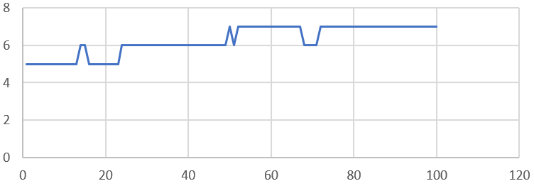
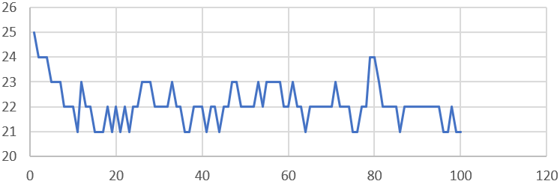
PSO Social Learning
Random Players
Case 1 (Reward =10, Cost =3)
Case 1 (Reward =10, Cost =3)
10 Workers
50 Workers

Slide 5
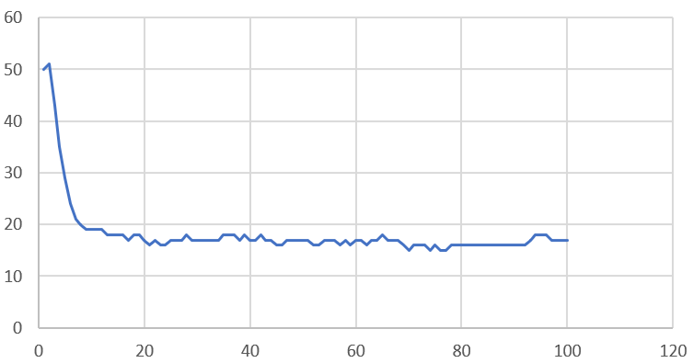
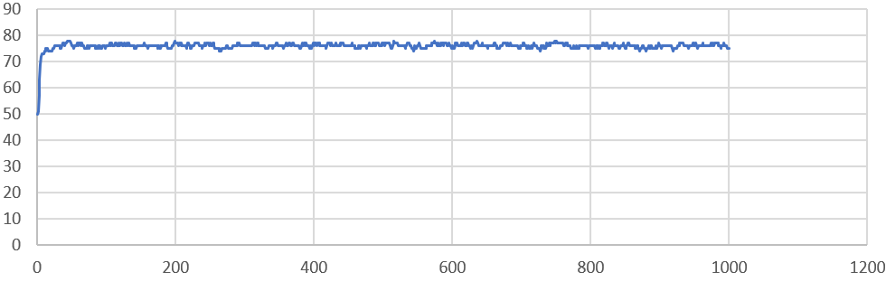
PSO Social Learning
Random Players
Case 2(Reward =10, Cost = U (8->12) )
Case 3 (Reward =10, Cost = U (-3->-1) )
Number of workers had no impact
Number of workers had no impact

Slide 6
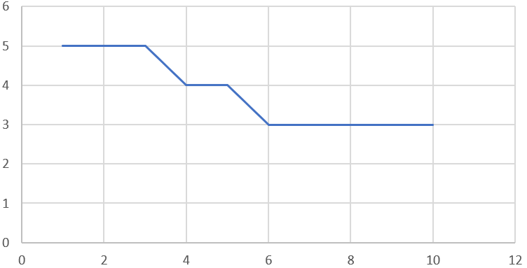
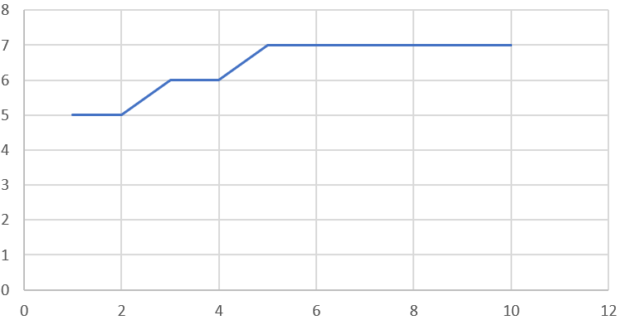
PSO Social Learning
Same Players
Case 1 (Reward =10, Cost =3)
Case 3 (Reward =10, Cost = U (-3->-1) )
Number of workers had no impact
Number of workers had no impact

Slide 7
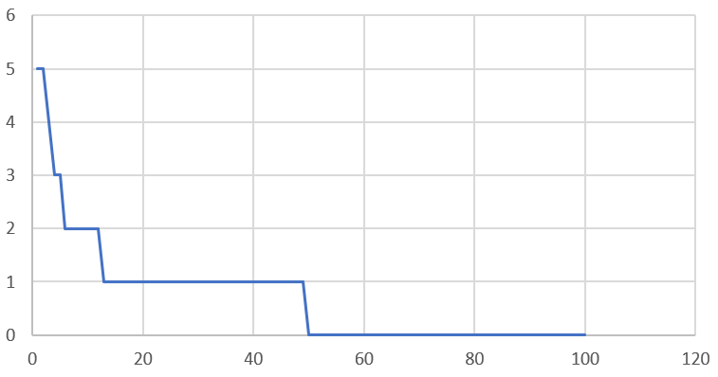
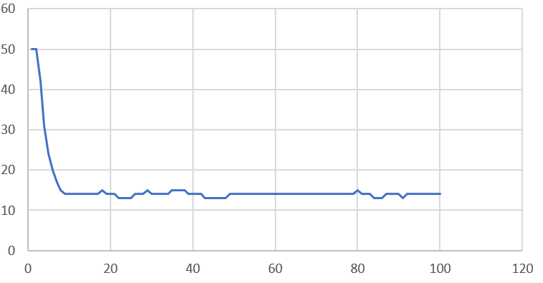
PSO Social Learning
Same Players
Case 2 (Reward =10, Cost = U (8->12) )
Case 2 (Reward =10, Cost = U (8->12) )
10 Workers
100 workers

Slide 8
Roth Erev Individual Learning
Repeating the game between random players or same players had no impact
Number of workers had no impact
Any reward is sufficient for a player to stick to their action
gaining confidence in the action and not changing it

Slide 9
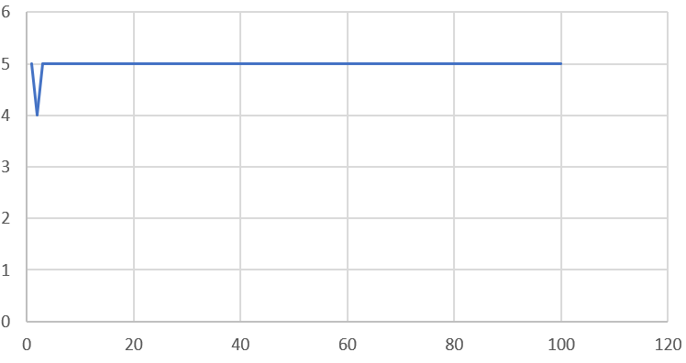
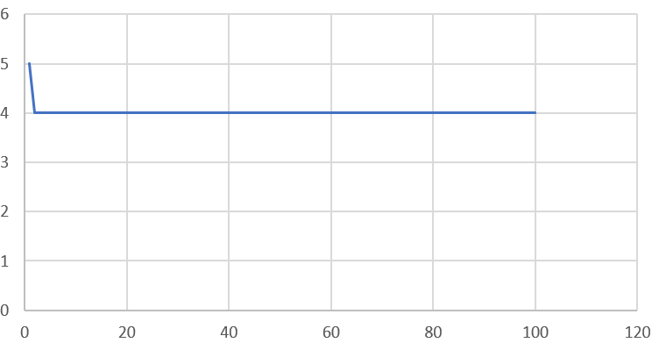
Roth Erev Individual Learning
Case 1 (Reward =10, Cost =3)
Case 2 (Reward =10, Cost = U (8->12) )
10 workers
10 workers

Slide 10
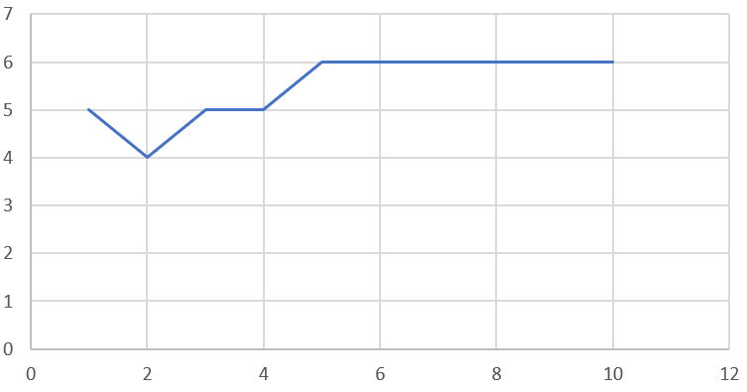
Roth Erev Individual Learning
Case 3 (Reward =10, Cost = U (-3->-1) )
10 workers

Slide 11
Thank you
Any question ?

